Slide 1
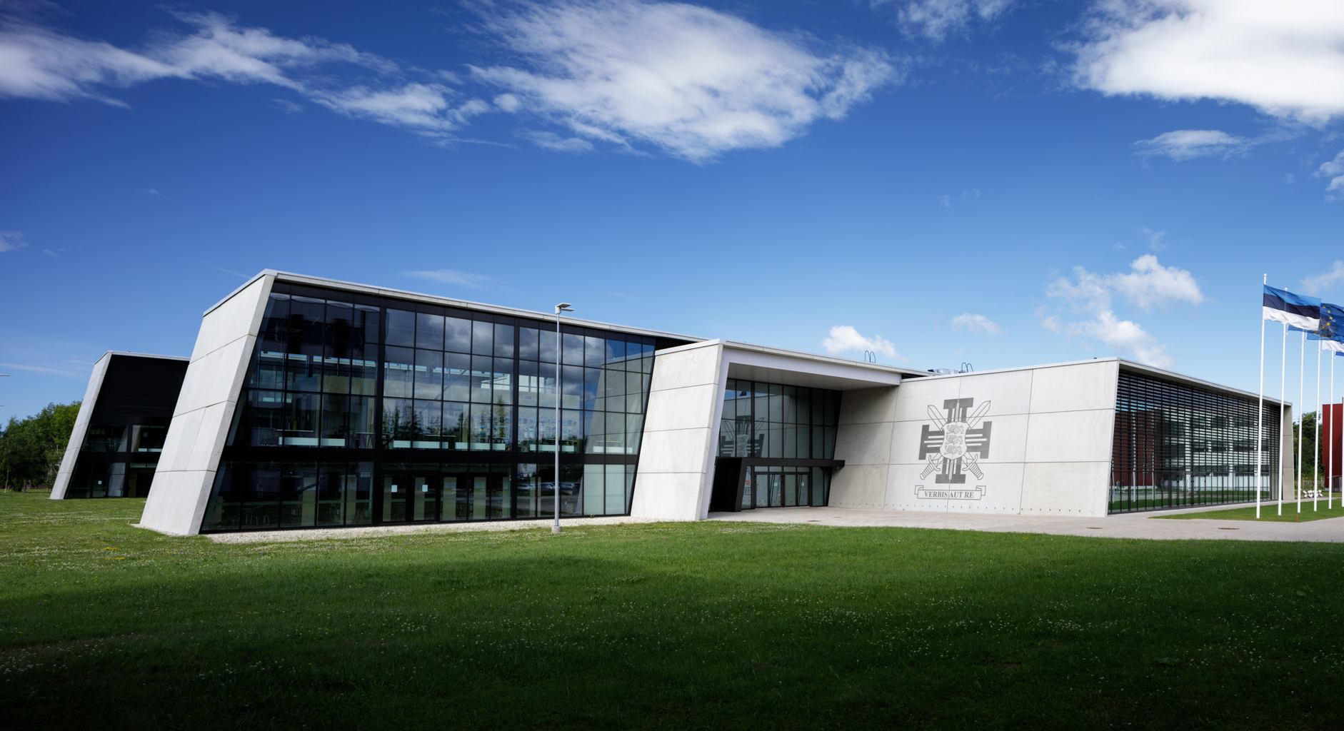



Educational Environment
Maret Miljan and Andryco Muuga
September 26-27, 2023

Slide 2


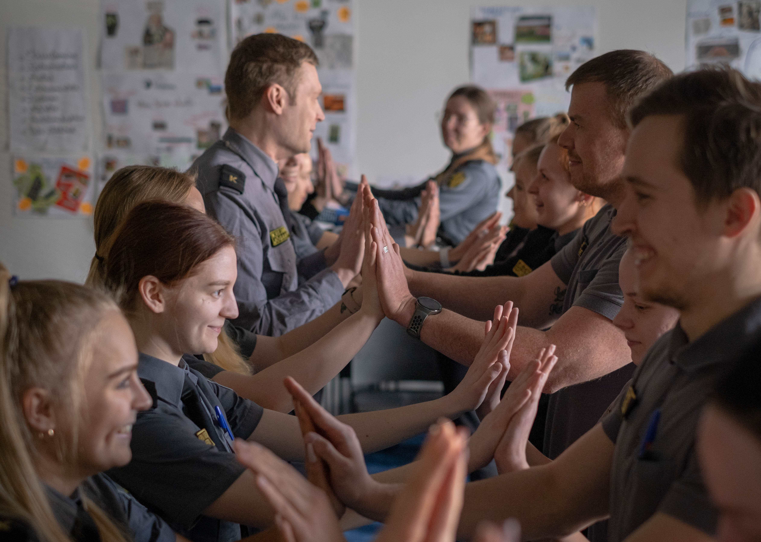
What do we need for deep effective learning?
Cognitive involvement - How much thinking is going on? How much effort is put in?
  Passive → Active → Constructive → Interactive
Student constructs new knowledge in his/her head
Student´s thinking is made visible
Student has tasks that enable to make meaningful mistakes and analyse it
Tasks are challenging for thinking and not too easy
There is no rush, stress, fear, anxiety or pressure in the learning situation

Slide 3

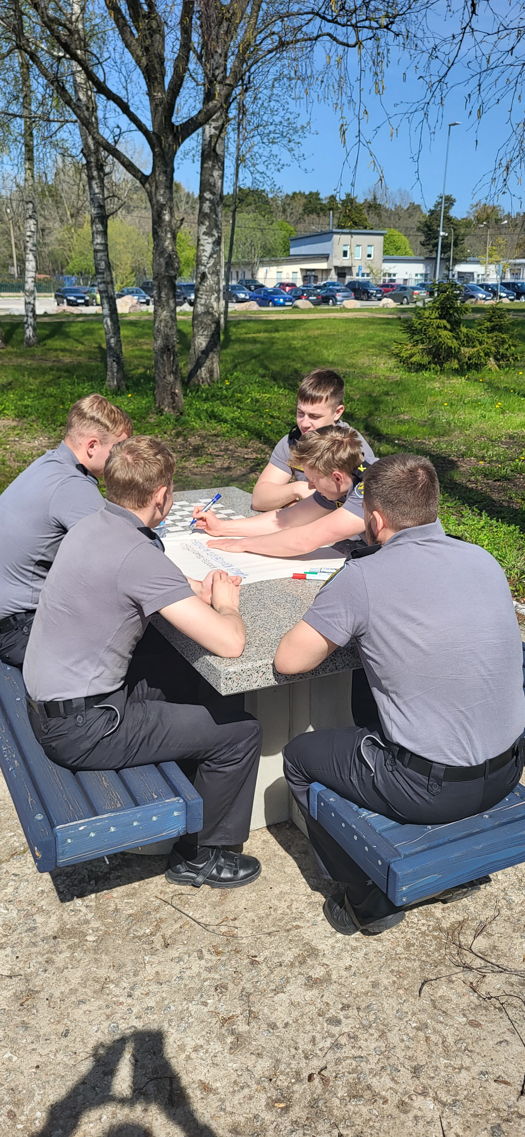
Components of
Educational Environment
Student
Self-esteem, sense of belonging, motivation, previous experience
Teacher
Method of teaching, teachers' personality, attitude towards students.
Physical/virtual environment
Building, classroom conditions, variety.
Effective web-based learning, web based tools, IT skills
Course, curriculum
Learning aims and outcomes, assessment methods, student support systems and informal activities.

Slide 4

References
Arro, G.(2023). In-depth learning - how to reach it? Presentation. Tallinn University Educational Sciences Institute.
Cantillon, P. (Ed.), 2003. ABC of learning and teaching in medicine. BMJ, London.
Michelene T. H. Chi & Ruth Wylie (2014) The ICAP Framework: Linking Cognitive Engagement to Active Learning Outcomes, Educational Psychologist, 49:4, 219-243
Saiyad, S., 2020. Educational environment and its application in Medical Colleges. J. Res. Med. Educ. Ethics 10, 3.

Slide 5
Group Work
20 min to share best practices or new ideas
Group 1: Student
How do we raise self-esteem? How do we create sense of belonging? How do we reduce stress? How do we create safe environment to make mistakes?
Group 2: Teacher
Hiring - experts becoming teachers? Which method of teaching to use to cognitively involve students? Design of the meaningul mistakes during learning? Teachers digital skills? Teachers' personality and attitude towards students?
Group 3: Physical/virtual environment
Importance of environment to support deep learning? School building or prison? Classroom conditions? Virtual tools? Safety? Stress?
Group 4: Course, curriculum
Curriculum design to support deep learning (based on learners experience)? Assessment methods? Student support systems and informal activities?

